Slide 1
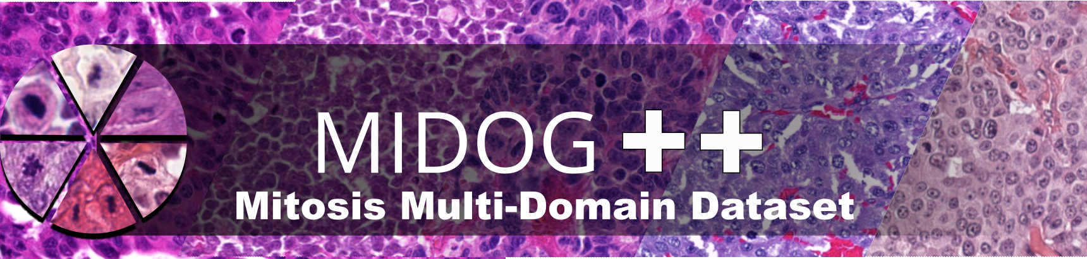
Data Augmentation
Naina Misra | Yang Cao | Lillian Lam | 02/26/2025
Notes:
Hi everyone! This is our weekly update for the mitotic identification group and today we’ll walk through the data augmentation approach for our histopathology pipeline that we’ve been working on for the past week.
The goal of this section is simple: because we’re working with limited data, we’re using augmentation to increase effective variety in training, and we’ll summarize what we tried, our results, and what we plan to do next.

Slide 2
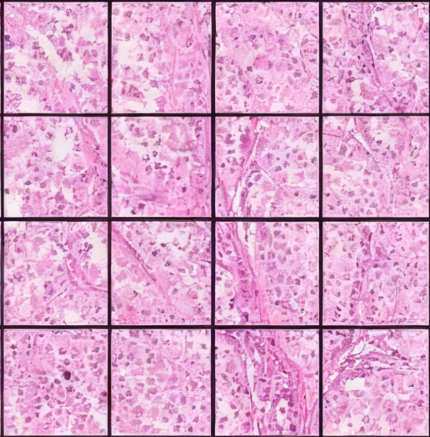
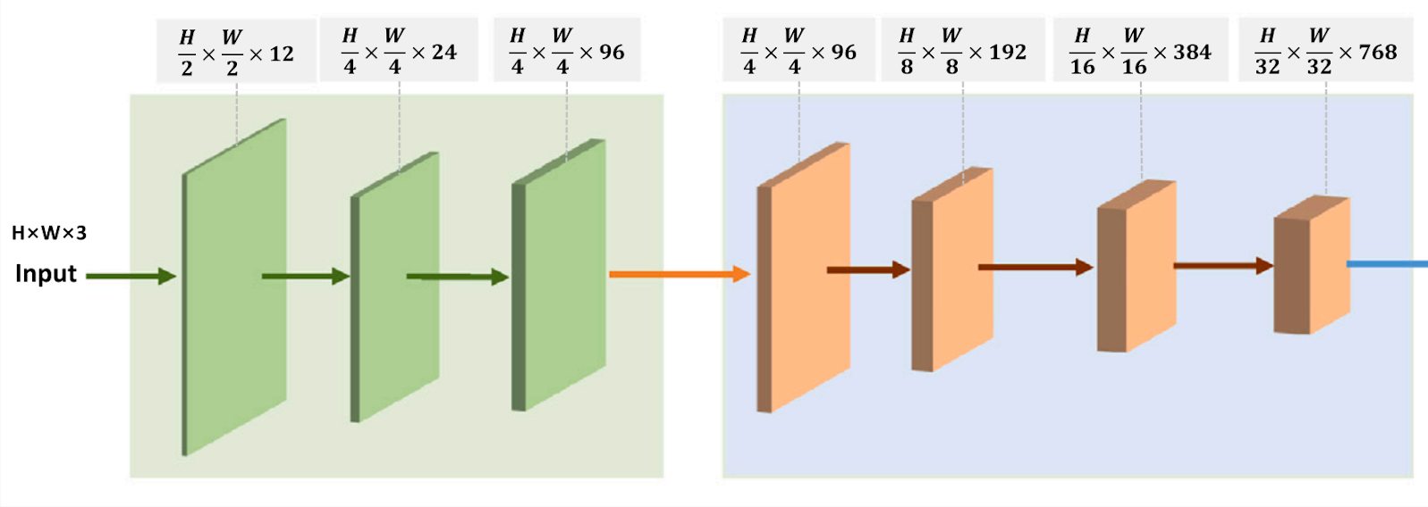
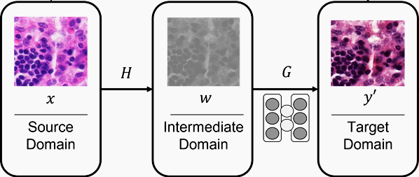
Recap
CTransPath Feature Extraction
Patch Extraction
CTransPath Feature Extraction
1x768 Feature Vector
Stain Normalized CTransPath Feature Extraction
Cycle GAN Stain Normalization
Patch Extraction
1x768 Feature Vector
CTransPath Feature Extraction
Notes:
Let me briefly recap our methodology. We‘re using CTransPath, a transformer-based feature extractor pretrained on histo pathology images. For each whole slide image, we extract patches, run them through CTransPath to get 768-dimensional feature vectors.
We also experimented with stain normalization using CycleGAN to see if we can reduce domain shifts by making images from different scanners look more similar before feature extraction.

Slide 3
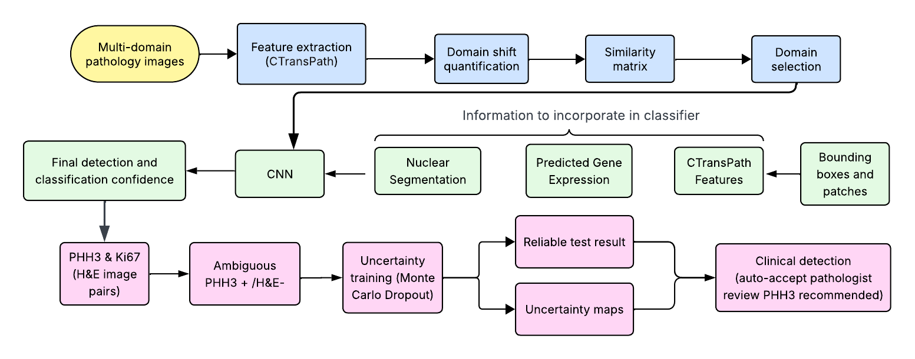
Pipeline
Notes:
Over the past weeks, we had worked to quantify the domain shift of our dataset. We had previously talked about creating a similarity matrix to input into our training and having an H&E to RNAseq gene incorporation into the final model. Now, we are moving on to actually testing a basic version of our model, which is a classifier with a Resnet50 backbone.

Slide 4
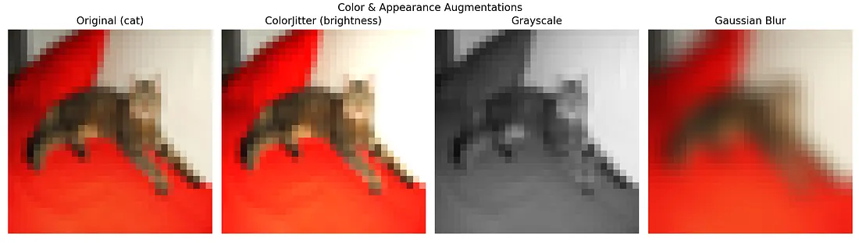
Data Augmentation
A technique to work with limited data (a common problem in machine learning) by expanding the dataset via image modifications. Through introducing greater image variety, model performance can be improved.
Notes:
We tested the model without any changes to the images themselves, and then moved on to the next step, data augmentation, in order to train a more capable model. Just as a quick introduction to what data augmentation is - it is essentially a technique that enables us to work with limited datasets, which are a common problem in machine learning, by copying and modifying existing images.
There are multiple methods to transform these images, some of which are up on the slide here, including colorjitter (changes the brightness), grayscale, and gaussian blur. There’s also cutmix, which cuts and pastes a part of one image over another image, and other things like crops and rotations. The goal is to improve the variety of images presented to the model for training so that it becomes more generalizable for novel image inputs.
For our dataset, we are working with about 500 total images, which we split into train/val/test sets at a 80:10:10 ratio, so our training set is roughly about 400 images, which might not necessarily be enough to encapsulate the full diversity of possible tumor histopathologies and lab and scanner differences, so we hoped to be able to use these tools to improve its overall performance.

Slide 5
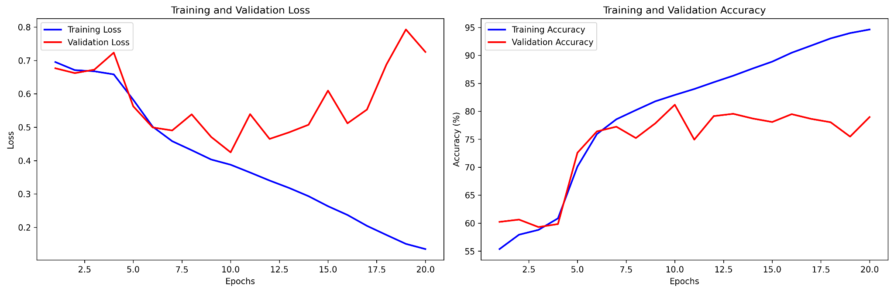
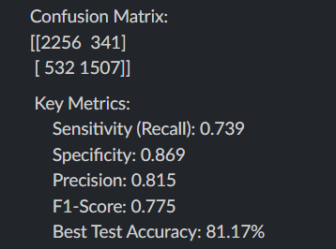
Initial Model (No Augmentation)
Confusion Matrix | Predicted non-mitotic | Predicted mitotic
Actual non-mitotic | TN | FP
Actual mitotic | FN | TP
Notes:
This is our initial model with no augmentation performed on the images. We can see here that validation loss is pretty high in comparison to training loss, and although the model fits to the training data well in the later epochs, evidenced by the training accuracy, the validation accuracy goes up and then flatlines around 80%. For the confusion matrix, I’ve added a handy key here to help identify what the values stand for, but we can see a pretty high number of false negatives, and the recall we got was about 0.74. From this, we can tell that the model is overfit to the training dataset.

Slide 6
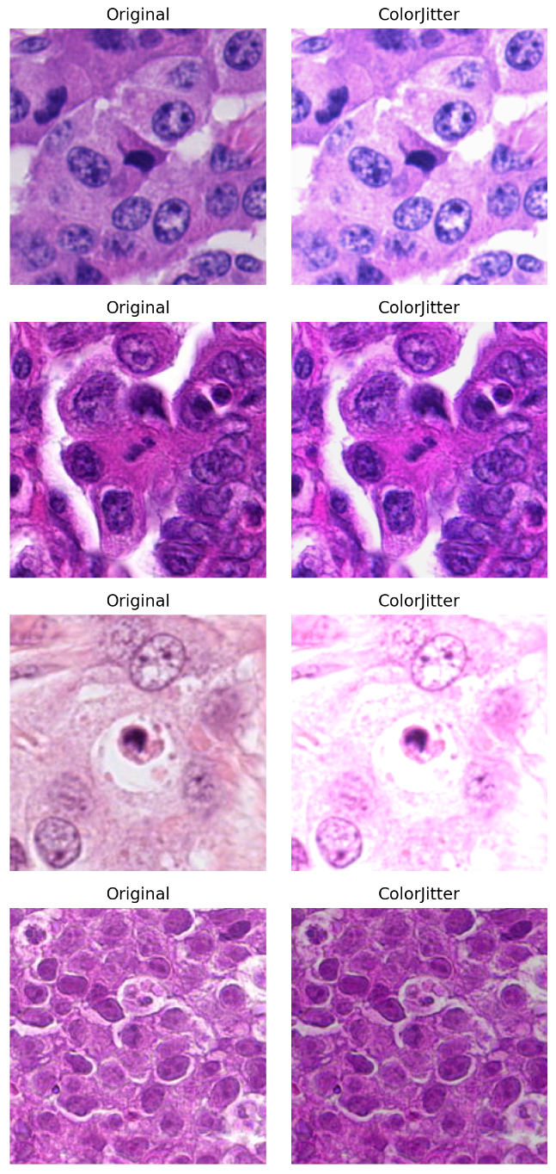
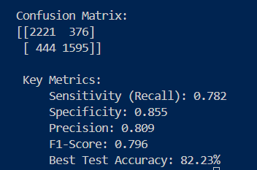
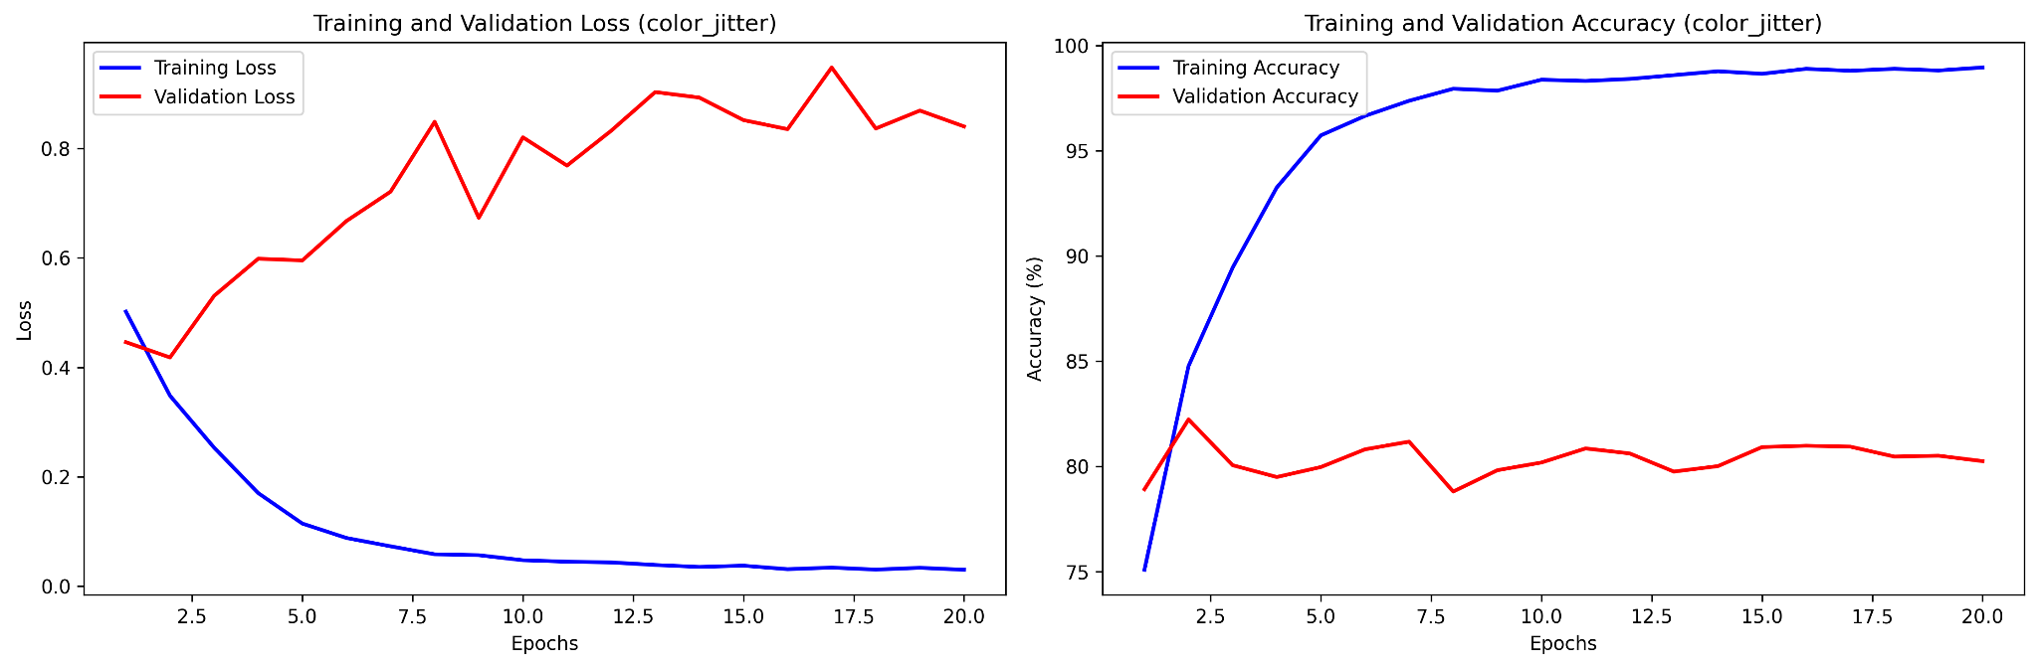
Color Jitter
100% images augmented
Notes:
For our first test, we used colorjitter, which changes the image brightness. There are a couple samples here of what the images look like before and after applying it on the right. The best test accuracy was about 82%, but as we can see here we have a consistently high validation loss and low validation accuracy in comparison to our training metrics, which means the model is overfitting on the training set.

Slide 7
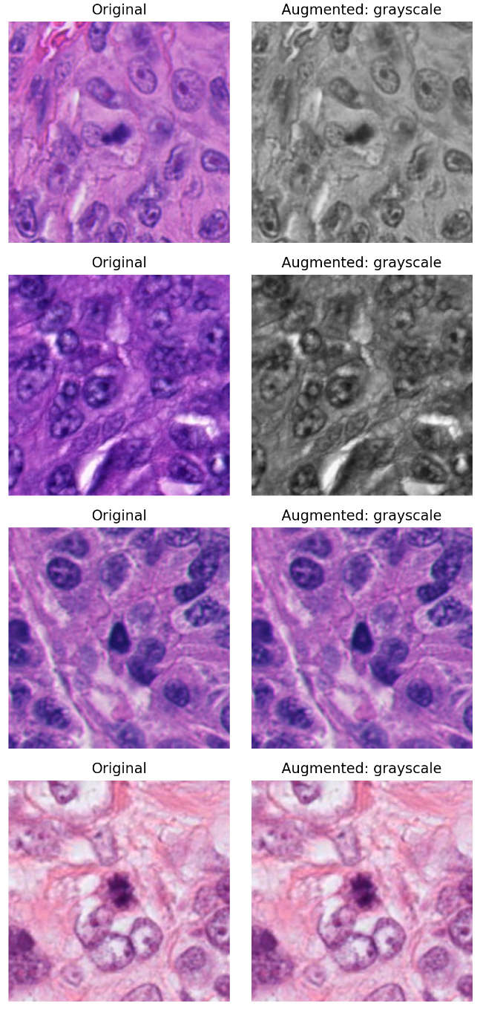
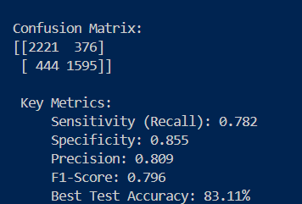
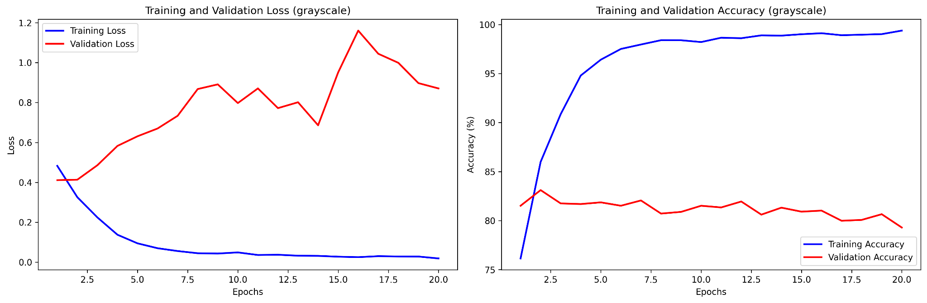
Grayscale
30% images augmented
Notes:
Next, we used grayscale, which we randomly applied to about 30% of the images. The best accuracy we got was similar (83%), and the loss and accuracy graphs are showing similar patterns.

Slide 8
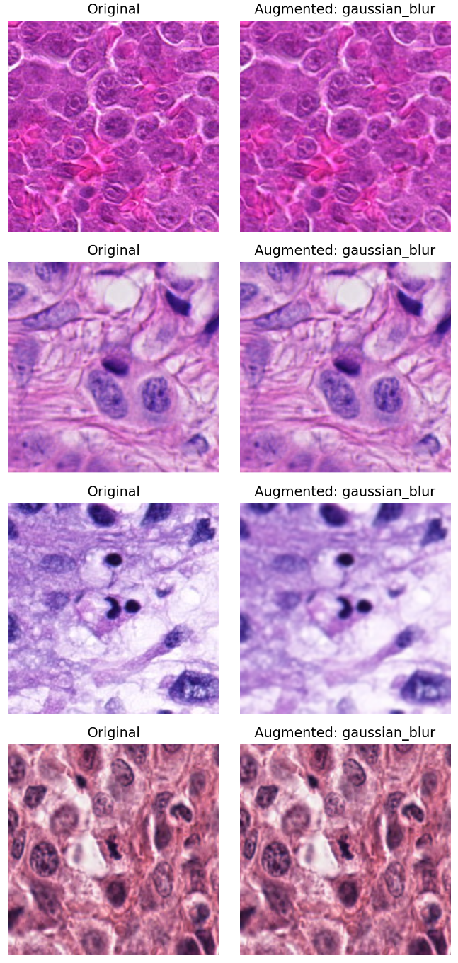
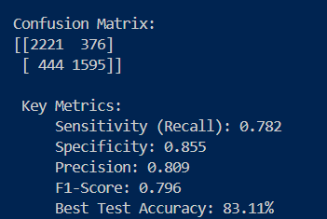
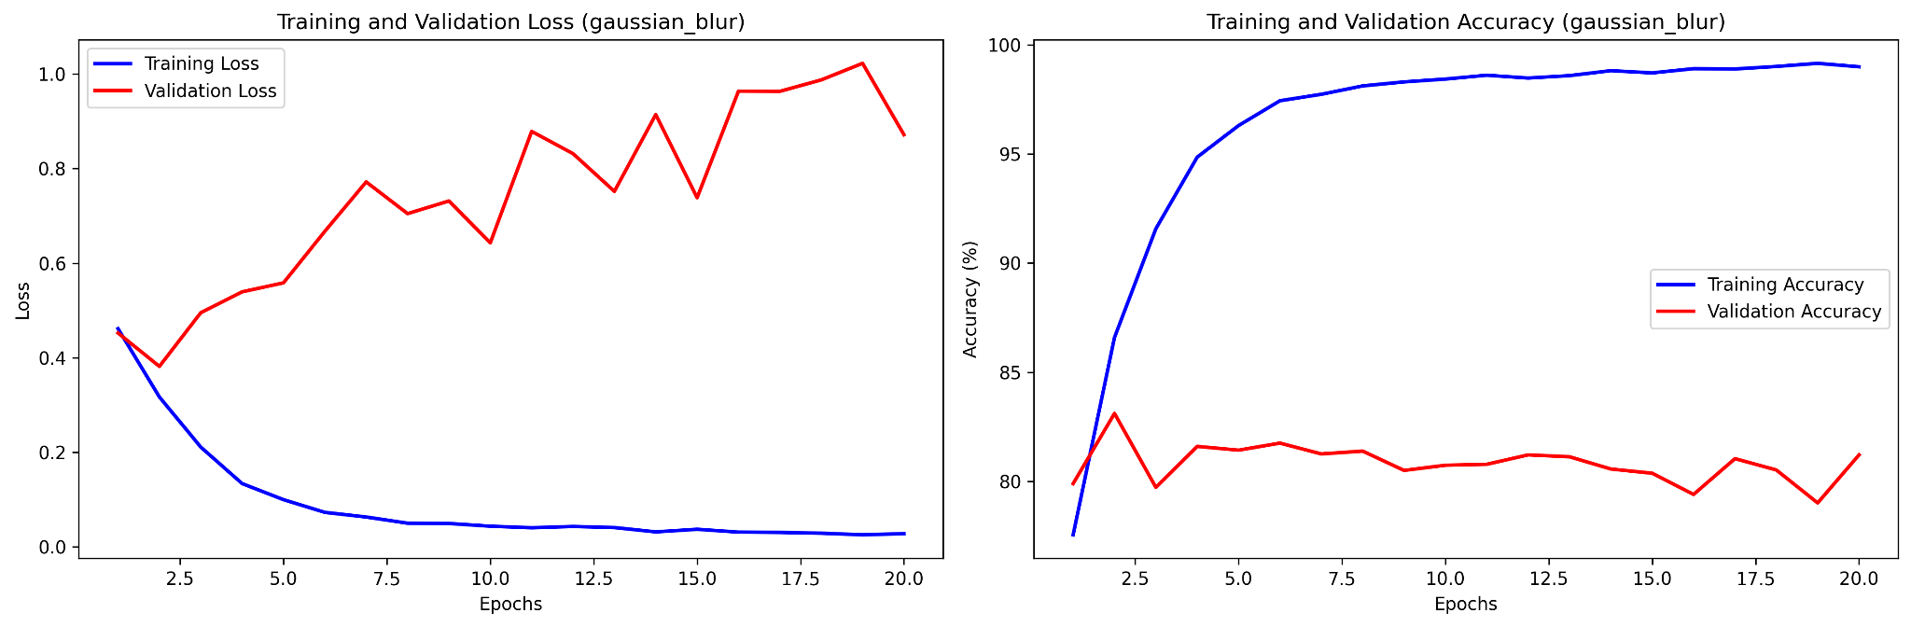
Gaussian Blur
30% images augmented
Notes:
Gaussian blur was applied to 30% of images as well, and once again we are seeing the same trends for the graphs.

Slide 9
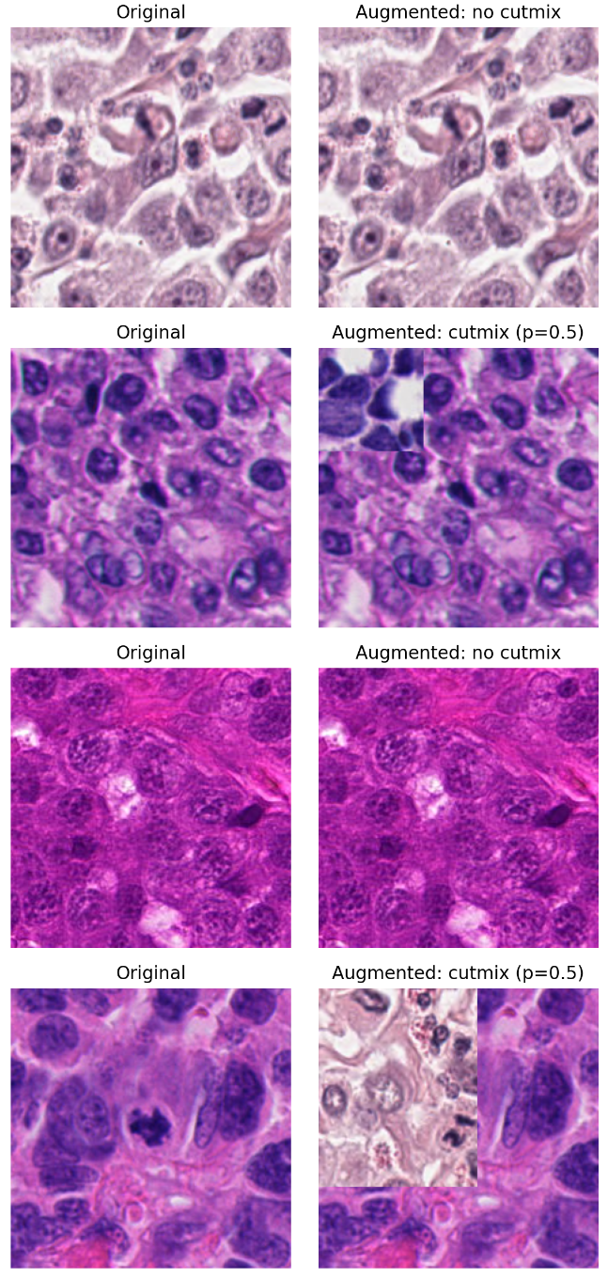
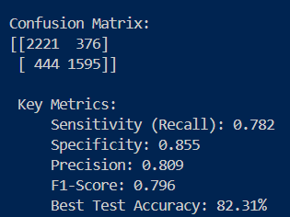
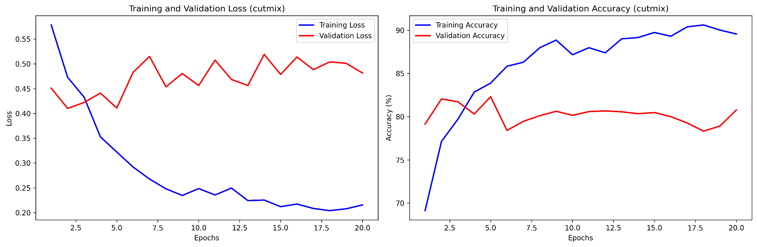
Cutmix
50% images augmented
Notes:
Finally, we used cutmix, applying it to 50% of the images. What’s interesting is the training dynamics: training accuracy is lower here, in the high 80s or so instead of the high 90s. So, CutMix is regularizing and making the task harder.
But validation accuracy still sits around 80–81%, so even though CutMix reduces overconfidence/overfitting, it doesn’t exactly translate into a validation jump.
On the test report, best test accuracy is about 82.3% and the sensitivity is still around 0.78, so we’re not solving the mitotic recall gap yet.

Slide 10
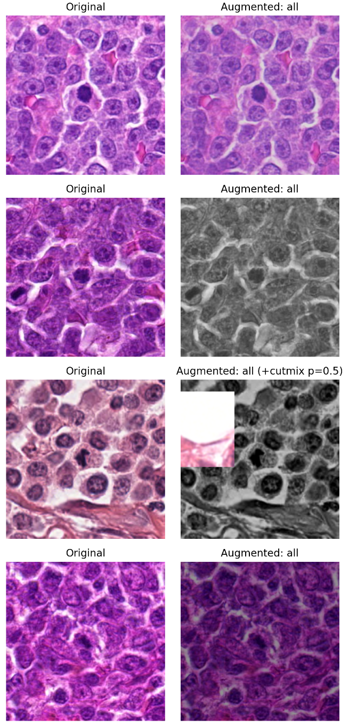
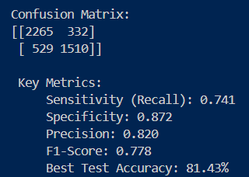
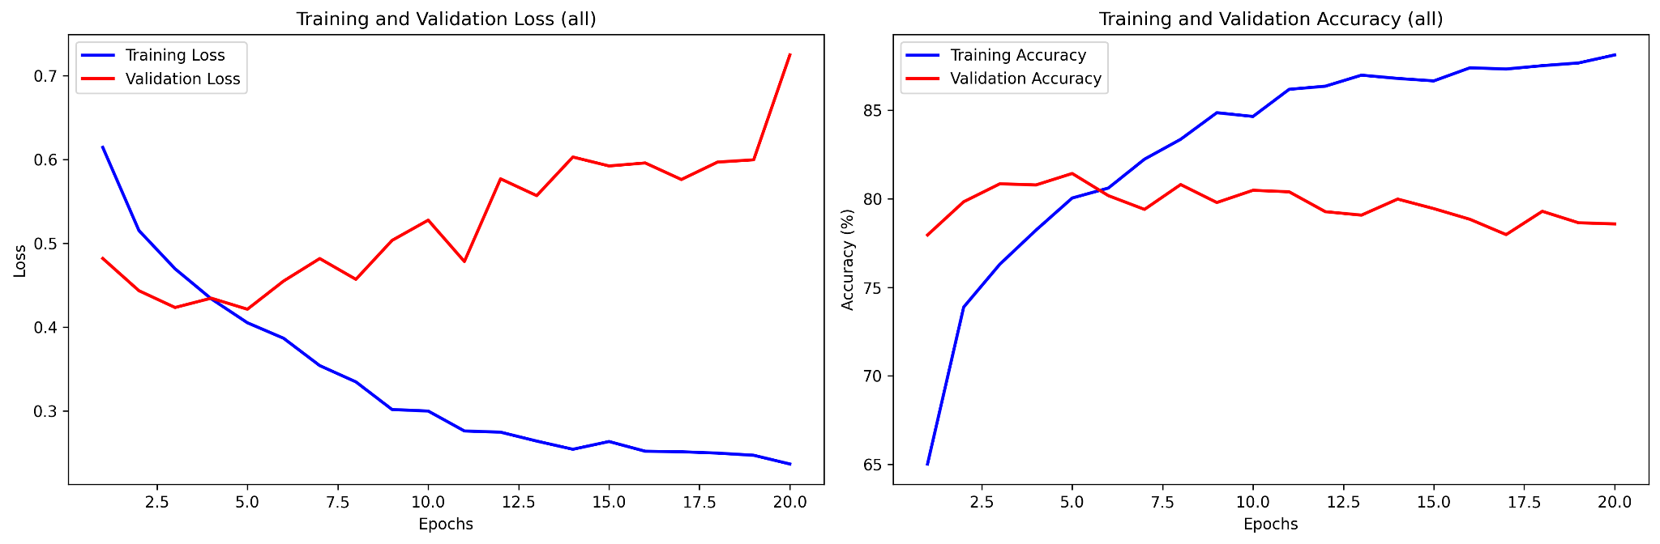
All
Randomized augmentation of all types
Notes:
At the end, we trained using all of the four types of augmentation at the same time. The confusion matrix shows more mitotic false negatives (529), and as we can see here the accuracy and recall both dropped, which might be a sign that there is too much augmentation going on and we may need to dial it back.

Slide 11
Limitations
Potential Solutions
Fast overfitting (5-6 epochs)
Training accuracy is high, validation plateaus around 80%
Noise at the patch level
~ 400 WSIs → 21k patches
Potentially reaching model limit
Reduce batch size/learning rate
Tune augmentation parameters
Test other augmentation types and identify most effective
Extracting biological features from WSIs
Notes:
For our current limitations, as shown by the results so far of our preliminary tests, our model is displaying very fast overfitting, which is happening in about 5 epochs regardless of the specific augmentation type. Training accuracy for the single-mode augmentation is pretty high, in the 90s, but validation is consistently platueaing in the 80s. Some possible reasons for this could be noise at the patch level, since we extracted 224x224 size patches from the WSIs, and background cells could contribute to noise.
With our dataset we are going from 400 WSIs in training to ~21k patches. Another possibility is that we might be reaching a model limit with our augmentation.
Some potential solutions we are planning to try moving forward include reducing the batch size and learning rate, tuning the augmentation parameters to see if having a different setting could improve the performance, and testing more types of augmentation. In addition, we are thinking of extracting biological features such as KI67 from our WSIs for training.

Slide 12
Next Steps
Continue training with Resnet50 classifier
Compare accuracy and F1 score to the ranked WSI images
Train on only Hematoxylin part of the WSI
Try a different H&E to Spatial Transcriptomics packages
Notes:
For our next steps we plan to continue our training with the Resnet50 classifier, compare accuracy and F1 score to the ranked WSI images Train on only Hematoxylin part of the WSI, and try a different H&E to spatial transcriptomics package

Slide 13
Thank you!
Notes:
That’s all. Thank you.
To Remove Technical Bias: Histopathology images vary wildly in color and contrast due to different scanners and staining protocols. We need normalization to force the model to focus on biological structures (like cell morphology) rather than superficial color styles.
As a Control Experiment: We use normalization to pinpoint the source of domain shift. By comparing distances before and after normalization, we found that 'Scanner Shift' dropped significantly (meaning it was mostly color), while 'Lab Shift' remained high. This proves that Lab Shift is structural, not just color-based."
We chose these three to capture the full spectrum of domain shift, as each metric measures a different statistical property:

